Slide 1
LLM2FEA: Discover Novel Designs with Generative Evolutionary Multitasking
Melvin Wong, Jiao Liu, Yew-Soon Ong, Thiago Rios, Stefan Menzel, Abhishek Gupta

Slide 2
Background
Recent advancements in generative models, including large language models and text-to-X generative models, have significantly influenced various fields and hold great promise in conceptual design.
The application of text-to-X generative models has the potential to generate designs that satisfy both visual and practicality when guided by user specifications in the form of a prompt. Such a prompt can be a text or other modalities in a free-form format.
The use of prompt not only ease user specification but also allows the generative models to synthesize virtually limitless possibilities, rendering an infinite exploration space.
However, such generative models are highly computational and resource expensive to train and inference, limiting its adoption in many design optimization scenarios. Furthermore, synthesizing from out-of-distribution prompts with mixed concepts is still a challenge, as text-to-X generative models will suffer from negative effects of hallucination.
This warrants for an investigation of efficient and effective optimization algorithms that can overcome the aforementioned challenges.
2

Slide 3
Motivation
Why use Large Language Model (LLM)? LLM learned from vast knowledge is able to generate human-machine interpretable and meaningful prompt of variable length. Furthermore, LLM has shown its capability in following instructions to complete complex optimization tasks and provide human-interpretable reasoning.
Why use evolutionary method? In contrast to conventional prompt optimization methods which confine search to local optima can result in stagnation of prompts, evolutionary methods possess better exploration capability, finding global optima through its variation and selection pressure processes.
Evolutionary multi-tasking: Presence of underlying inter-tasks relationship allows implicit transfer of knowledge, thereby improving the convergence characteristics of evolutionary methods. This property allows mixture of concepts through inter-pollination of prompts, transferring some characteristics of a concept to another in the generative process.
Leveraging on aforementioned qualities, we proposed a novel LLM driven multi-factorial evolutionary algorithm (LLM2FEA) that imparts evolutionary processes in large language model, with the aim of producing sets of prompt sets in one pass for multi-task optimization.
3

Slide 4
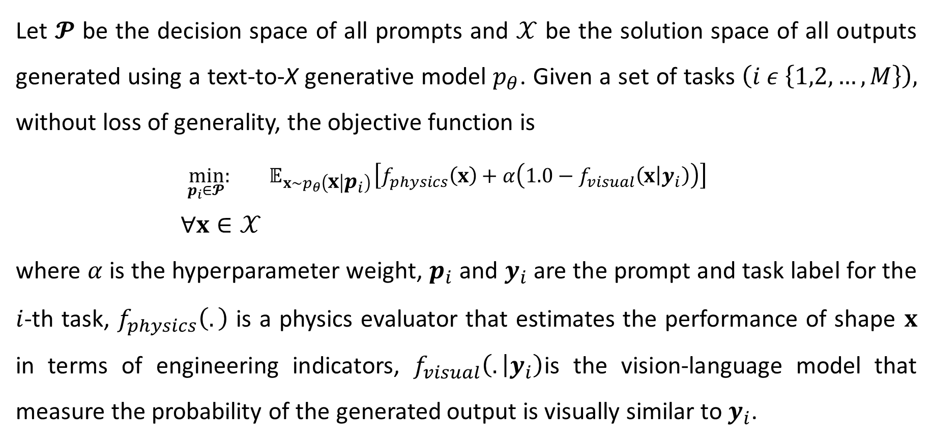
General Formulation
Let $𝓟$ be the decision space of all prompts and $𝒳$ be the solution space of all outputs generated using a text-to-X generative model $p_{θ}$. Given a set of tasks $\left(i ε \left\{1,2,…,M\right\}\right),$ without loss of generality, the objective function is
$$\min_{p_{i}∈𝓟}{:{ 𝔼}_{x\sim p_{θ}\left(x | p_{i}\right)}\left[f_{physics}\left(x\right)+α\left(1.0−f_{visual}\left(x | y_{i}\right)\right)\right]}$$
$$∀x∈𝒳$$
where $α$ is the hyperparameter weight, $p_{i}$ and $y_{i}$are the prompt and task label for the $i$-th task, $f_{physics}\left(.\right)$ is a physics evaluator that estimates the performance of shape $x$ in terms of engineering indicators, $f_{visual}\left(. | y_{i}\right)$is the vision-language model that measure the probability of the generated output is visually similar to $y_{i}$.
4

Slide 5
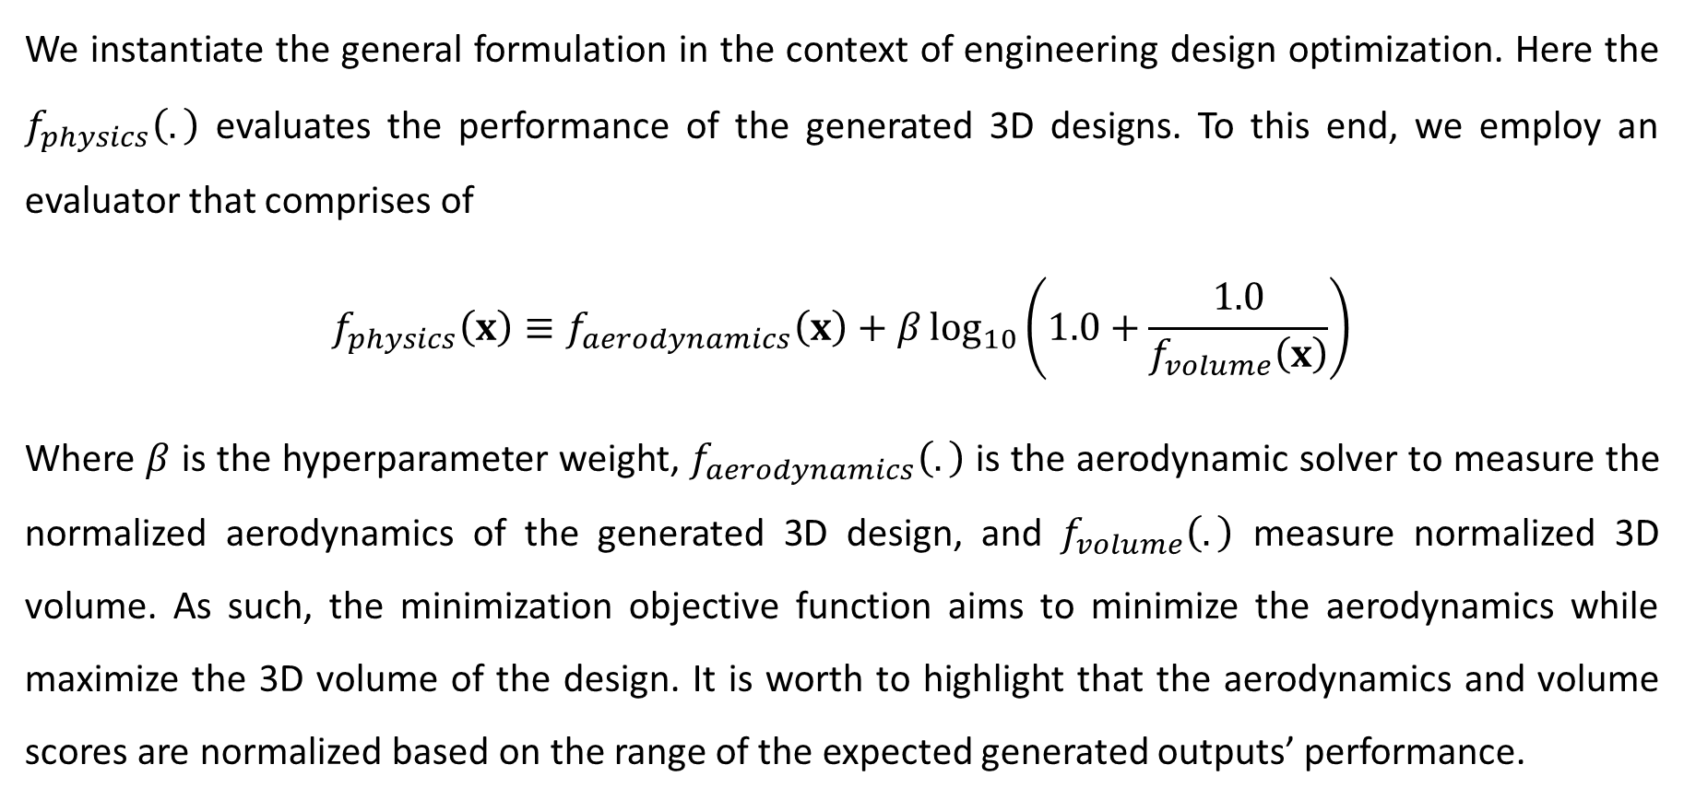
Formulation for Engineering Conceptual Design Discovery
We instantiate the general formulation in the context of engineering design optimization. Here the $f_{physics}\left(.\right)$ evaluates the performance of the generated 3D designs. To this end, we employ an evaluator that comprises of
$$f_{physics}\left(x\right)≡f_{aerodynamics}\left(x\right)+β\log_{10}\left(1.0+\frac{1.0}{f_{volume}\left(x\right)}\right)$$
Where $β$ is the hyperparameter weight, $f_{aerodynamics}\left(.\right)$ is the aerodynamic solver to measure the normalized aerodynamics of the generated 3D design, and $f_{volume}\left(.\right)$ measure normalized 3D volume. As such, the minimization objective function aims to minimize the aerodynamics while maximize the 3D volume of the design. It is worth to highlight that the aerodynamics and volume scores are normalized based on the range of the expected generated outputs’ performance.
5

Slide 6
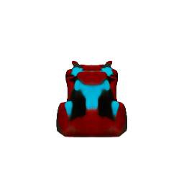
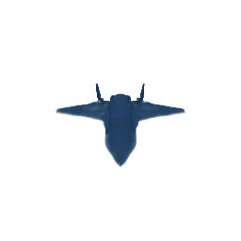
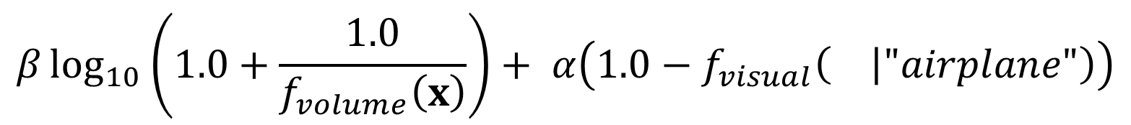

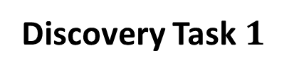
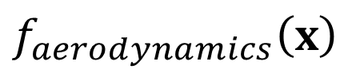
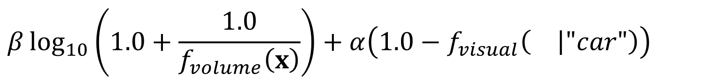
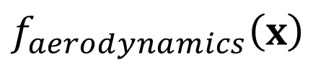
Illustration of Multi-Task Scenario
For example, the objective function for $M$ tasks will be
Discovery Task $1$
$$β\log_{10}\left(1.0+\frac{1.0}{f_{volume}\left(x\right)}\right)+α\left(1.0−f_{visual}\left( | "car"\right)\right)$$
$$f_{aerodynamics}\left(x\right)$$
+
…
…
Discovery Task $M$
$$β\log_{10}\left(1.0+\frac{1.0}{f_{volume}\left(x\right)}\right)+ α\left(1.0−f_{visual}\left( | "airplane"\right)\right)$$
$$f_{aerodynamics}\left(x\right)$$
+
6

Slide 7
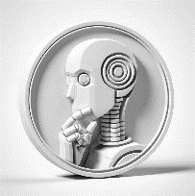

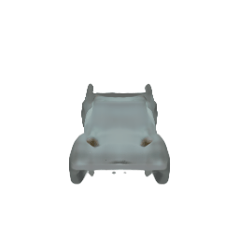
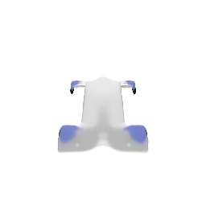


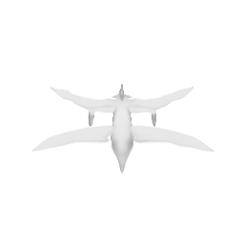
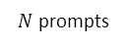
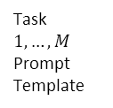
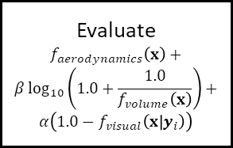
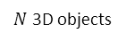
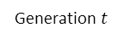
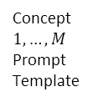
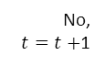
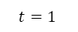
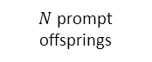
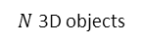

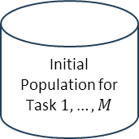
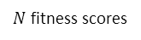
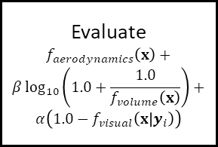
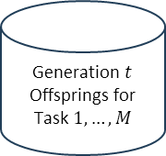
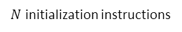


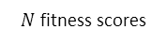
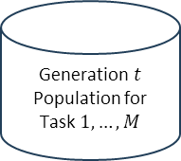

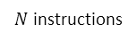
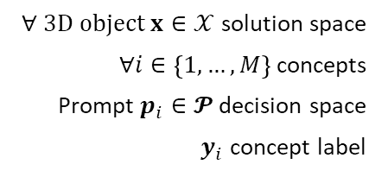
LLM2FEA Method Overview
Initialize
Task $1,…,M$
Prompt Template
Terminate
Condition Satisfied?
Tournament Selection
$∀ 3D object x∈𝒳$ solution space
$∀i∈\left\{1,…,M\right\}$ concepts
Prompt $p_{i}∈𝓟$ decision space
$y_{i}$ concept label
Start
End
Yes
$N$initialization instructions
Reflect
No,
$t=t+$1
LLM
Initial
Population for Task $1,…,M$
Generation $t$ Population for Task $1,…,M$
Generation $t$ Offsprings for Task $1,…,M$
$N$ prompts
$$t=1$$
$N$ fitness scores
Crossover & Mutate
Text-to-3D model
$$∪$$
$$x\sim p_{θ}\left(x | p_{i}\right)$$
Concept $1,…,M$
Prompt Template
$N$ 3D objects
…
Evaluate
…
…
…
…
…
Evaluate
$$f_{aerodynamics}\left(x\right)+$$
$$β\log_{10}\left(1.0+\frac{1.0}{f_{volume}\left(x\right)}\right)+$$
$$α\left(1.0−f_{visual}\left(x | y_{i}\right)\right)$$
Evaluate
$$f_{aerodynamics}\left(x\right)+$$
$$β\log_{10}\left(1.0+\frac{1.0}{f_{volume}\left(x\right)}\right)+$$
$$α\left(1.0−f_{visual}\left(x | y_{i}\right)\right)$$
Setup
Instructions for Stochastic Pollination
…
$N$ prompt offsprings
…
$N$ instructions
$N$ 3D objects
Select
$N$ fitness scores
Generation $t$
LLM
(Reflect, Select, Crossover, Mutate)
Text-to-3D
model
$$x\sim p_{θ}\left(x | p_{i}\right)$$
LLM Conditioning
Reflect Gen. $t$ Population
Self-Mating
Inter-Tasks Mating (Implicit Genetic Transfer)
Intra-Task Mating
A <text-to-3D> model synthesizes a 3D object from a prompt. You are a prompt generator for the <text-to-3D> model. Your task is to generate prompt with best <task_i> fitness score for the 3D <task_i> object synthesized by <text-to-3D> model. The fitness score is a combination of <task_i> <aerodynamics> and <task_i> 3D volume. Hence, a best fitness score for a 3D object is one with minimum possible <task_i> <aerodynamics> and maximum feasible <task_i> 3D volume.
Below is the list of your previous prompts and its corresponding fitness score, <aerodynamics> value, and 3D volume value:
1. <prompt_1> <aerodynamics> <aerodynamics_value_1>, 3D volume <3D_volume_value_1>
…
<N>. <prompt_N> <aerodynamics> <aerodynamics_value_N>, 3D volume <3D_volume_value_N>
Please follow the instructions step-by-step to generate a new prompt.
Step 1: Reflect, on your previous prompts, why and how each prompt yields its fitness score, <objective> value, 3D volume value.
Step 2: Randomly select any <task_i> prompt.
Step 3: Generate a new prompt by mutating the prompt chosen in Step 2. You can mutate the generated prompt by replacing any words with other words that will yield a 3D <task_i> object with a better <task_i> fitness score than the prompt chosen in Step 2. The prompt must first start with "A <task_i> in the shape of" and ends with a full stop.
Step 4: Keep the generated prompt in Step 3. Repeat step 1 to 3 until you have <N> generated prompts.
Please follow the instructions step-by-step to generate a new prompt.
Step 1: Reflect, on your previous prompts, why and how each prompt yields its fitness score, <aerodynamics> value, 3D volume value.
Step 2: Randomly select any <task_i> prompt and select another prompt not in the <task_i> prompts list.
Step 3: Generate a new prompt by crossover the prompts chosen in Step 2. You can crossover two prompts by taking any sub-words in one prompt and combine with any sub-words in the other prompt.
Step 4: Generate a new prompt by mutating the prompt generated in Step 3. You can mutate the generated prompt by replacing any words with other words that will yield a 3D <task_i> object with a better <task_i> fitness score than the two prompts chosen in Step 2. The prompt must first start with "A <task_i> in the shape of" and ends with a full stop.
Step 5: Keep the generated prompt in Step 4. Repeat step 1 to 4 until you have <N> generated prompts.
Please follow the instructions step-by-step to generate a new prompt.
Step 1: Reflect, on your previous prompts, why and how each prompt yields its fitness score, <aerodynamics> value, 3D volume value.
Step 2: Randomly select any two <task_i> prompts.
Step 3: Generate a new prompt by crossover the prompts chosen in Step 2. You can crossover two prompts by taking any sub-words in one prompt and combine with any sub-words in the other prompt.
Step 4: Generate a new prompt by mutating the prompt generated in Step 3. You can mutate the generated prompt by replacing any words with other words that will yield a 3D <task_i> object with a better <task_i> fitness score than the two prompts chosen in Step 2. The prompt must first start with "A <task_i> in the shape of" and ends with a full stop.
Step 5: Keep the generated prompt in Step 4. Repeat step 1 to 4 until you have <N> generated prompts.
Prompt Initialization
The prompt must first start with “A <task_i> in the shape of” and end with a full stop. Predict the <task_i> fitness score for the generated 3D <task_i> object using the prompt.
Can you generate <K=N / num_task> prompts?
7

Slide 8
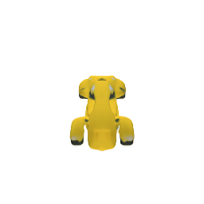
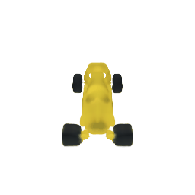
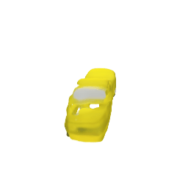
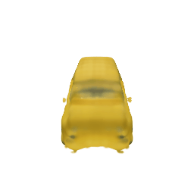

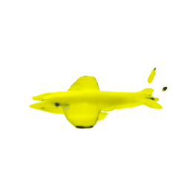
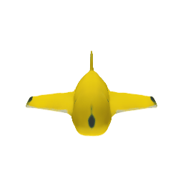
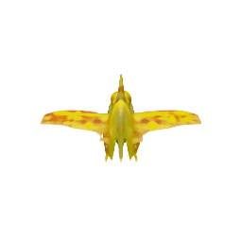
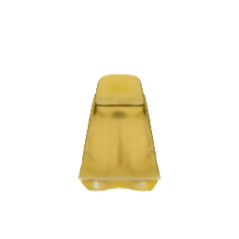
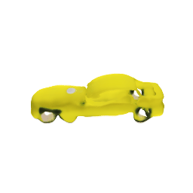
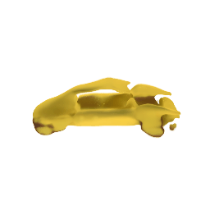
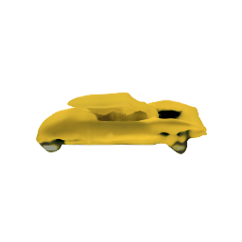
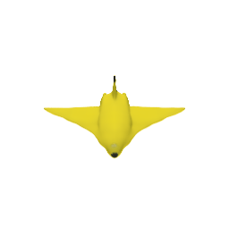
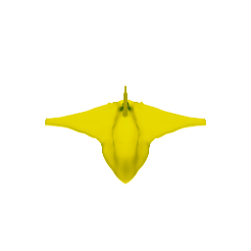
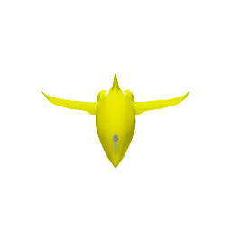

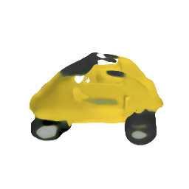
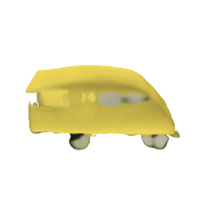
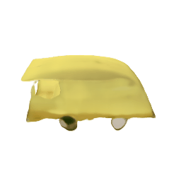
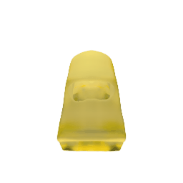





















LLM2FEA Results
Initial
Gen-1
Gen-5
Gen-7
Initial
Gen-1
Gen-5
Gen-7
Prompt Set for a Banana Car
Prompt Set for a Banana Airplane
A banana car in the shape of a off-road SUV with a sturdy banana structure and rugged peel exterior.
A banana car in the shape of a retro classic yellow van with plush banana-themed seats and tropical sunshine exterior details radiating freshness and joy.
A banana airplane in the shape of a classic biplane with a spinning propeller.
A banana airplane in the shape of a classic flying vintage rocket with sleek yellow propellers and a vibrant banana fuselage for smooth banana flights.
$$f_{physics}≡f_{drag}+f_{volume}+f_{visual}$$
8

Slide 9
LLM2FEA Instructions (Simplified)
(a) Description of Problem
(d) Self-Mating
A <text-to-3D> model synthesizes a 3D object from a prompt. Your task is to generate prompt with best <discovery_task_i> fitness score for the 3D <discovery_task_i> object synthesized by <text-to-3D> model.
Please follow the instructions step-by-step to generate a new prompt.
Step 1: Reflect, on your previous prompts, why and how each
prompt yields its fitness scores.
Step 2: Randomly select any <discovery_task_i> prompt.
Step 3: Generate a new prompt by mutating the prompt chosen in
Step 2. The prompt must first start with "A
<discovery_task_i> in the shape of" and ends with a full stop.
Step 4: Keep the generated prompt in Step 3. Repeat step 1 to 3
until you have <N> generated prompts.
(b) Population Initialization
(e) Inter-Tasks Mating (Implicit Genetic Transfer)
The prompt must first start with “A <discovery_task_i> in the shape of” and end with a full stop. Predict the <discovery_task_i> fitness score for the generated 3D <discovery_task_i> design using the prompt. Can you generate <N / num_tasks> prompts?
Please follow the instructions step-by-step to generate a new prompt.
Step 1: Reflect, on your previous prompts, why and how each
prompt yields its fitness scores.
Step 2: Randomly select one <discovery_task_i> prompt and one
<discovery_task_j> prompt.
Step 3: Generate a new prompt by crossover the prompts chosen in
Step 2.
Step 4: Generate a new prompt by mutating the prompt generated
in Step 3. The prompt must first start with "A
<discovery_task_i> in the shape of" and ends with a full stop.
Step 5: Keep the generated prompt in Step 4. Repeat step 1 to 4 until
you have <N> generated prompts.
(c) In-context examples (population)
(f) Intra-Task Mating
Below is the list of your previous prompts and its corresponding fitness scores:
1. <prompt_1> <fitness_name> <fitness_score_1>
2. <prompt_2> <fitness_name> <fitness_score_2>
3. <prompt_3> <fitness_name> <fitness_score_3>
…
<N>. <prompt_N> <fitness_name> <fitness_score_N>
Please follow the instructions step-by-step to generate a new prompt.
Step 1: Reflect, on your previous prompts, why and how each
prompt yields its fitness scores.
Step 2: Randomly select any two <discovery_task_i> prompts.
Step 3: Generate a new prompt by crossover the prompts chosen in
Step 2.
Step 4: Generate a new prompt by mutating the prompt generated in
Step 3. The prompt must first start with "A
<discovery_task_i> in the shape of" and ends with a full stop.
Step 5: Keep the generated prompt in Step 4. Repeat step 1 to 4 until
you have <N> generated prompts.
9

Slide 10









































LLM2FEA Results
Initial
Gen-1
Gen-10
Gen-20
Initial
Gen-1
Gen-10
Gen-20
(a) “A airplane in the shape of…”
(b) “A car in the shape of…”
$$f_{physics}≡f_{frontal_area}+f_{visual}$$
10

Slide 11



LLM2FEA Results
Car Prompt Parent:
“A car in the shape of a sleek shark dagger soaring through streamlined foils and sharp peaks to minimize aerodynamic resistance.”
Crossover Prompt:
“A car in the shape of a sleek shark dagger soaring through streamlined foils wing with elegant silhouette and sharp peaks to minimize aerodynamic resistance.”
Mutated Offspring Prompt:
“A car in the shape of a streamlined shark silhouette employing sleek spear wing refinement for optimal aerodynamic efficiency.”
Airplane Prompt Parent:
“A airplane in the shape of an agile wing with elegant silhouette, optimized for minimal profile and speed.”
11

Slide 12










































LLM2FEA Results
Initial
Gen-1
Gen-10
Gen-20
Initial
Gen-1
Gen-10
Gen-20
(a) “A airplane in the shape of…”
(b) “A car in the shape of…”
$$f_{physics}≡f_{drag}+f_{volume}+f_{visual}$$
12

Slide 13







































LLM2FEA Results
Initial
Gen-1
Gen-3
Gen-5
Initial
Gen-1
Gen-3
Gen-5
(a) “A banana airplane in the shape of…”
(b) “A banana car in the shape of…”
$$f_{physics}≡f_{drag}+f_{volume}+f_{visual}$$
13

Slide 14


LLM2FEA Results
“A banana airplane in the shape of a whimsical and unique flying machine adorned with rainbow-colored wings and a smiling banana pilot at the helm.”
“A banana car in the shape of a futuristic vehicle blending the curves of a banana with innovative design elements.”
14

